Slide 1

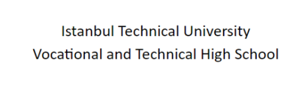

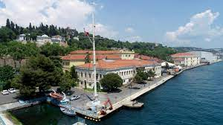
İTÜ MTAL
https://youtu.be/4urT9ivoFQA?si=DOvpV-AOJ-ETeyty
2023-2024

Slide 2




About School
With a protocol between the Ministry of National Education (MEB) and Istanbul Technical University (ITU), ITU Vocational and Technical Anatolian High School was established in 2019.
Every year 90 students are admitted;
30 IT Department,
30 Maritime Department,
30 Electrical-Electronics Department,
Independent Industrialists and Businessmen's Association

Slide 3
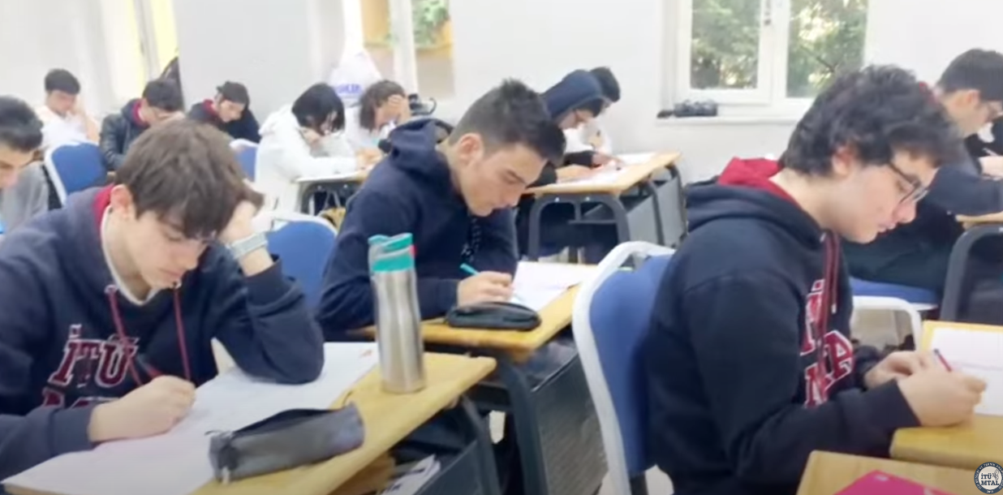
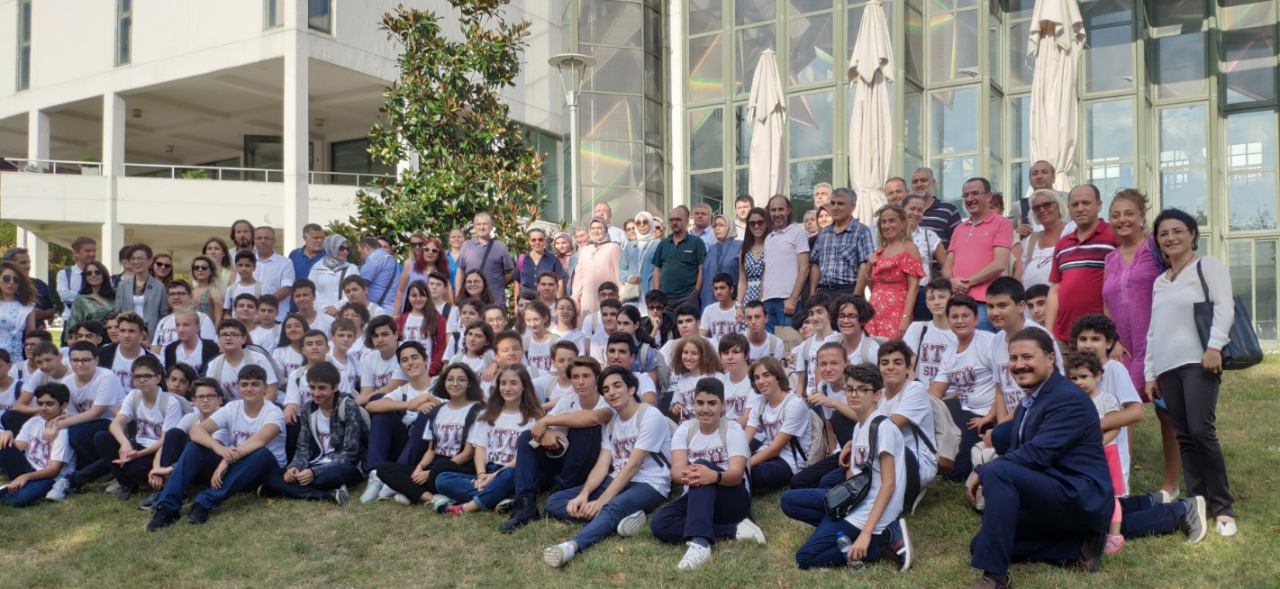
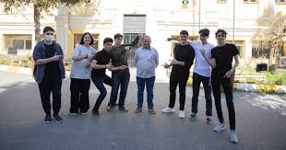
About School
Students are enrolled through the High School Transition System (LGS) exam.
Education is 5 years,
1 year of preparatory English language training,
4 years high school education.

Slide 4

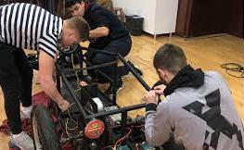
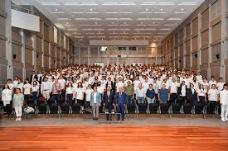
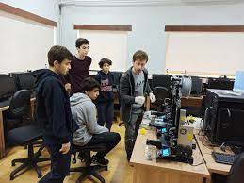
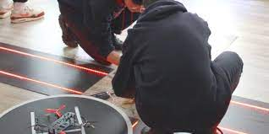
School Staff
4 math
1 physics
1 chemistry
3 Turkish literature
5 English
1 history
1 geography
1 philosophy
1 religion culture
1 arts
1 physical education
4 maritime
3 information technologies
2 electric electronics
4 administrators
3 helping personnel

Slide 5
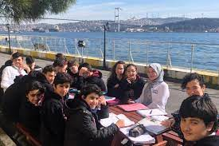
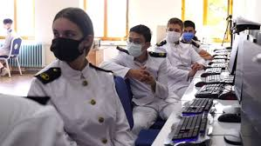
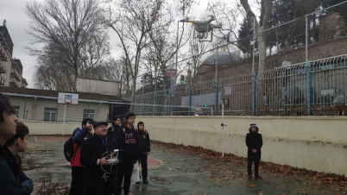
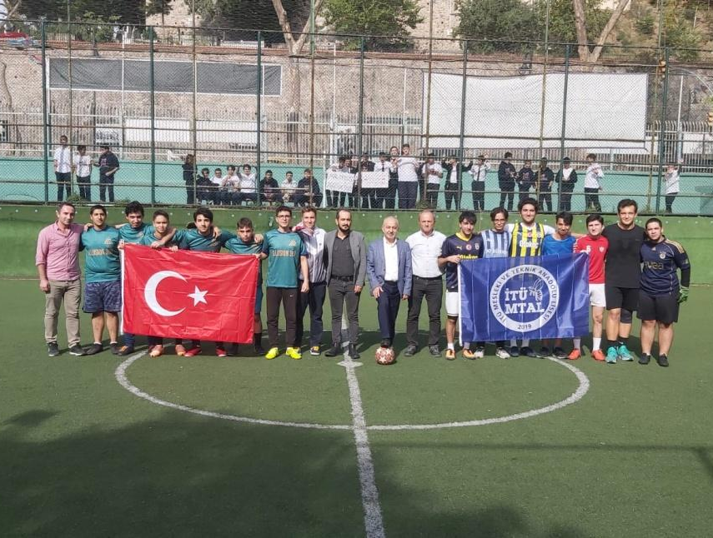
Facilities at the School
Classroom 15
Auditorium 1
Library 1
Electric-Electronic Workshops 2
IT Classrooms 2
Masjid 2 (Girls + Boys)
Guidance services
Volleyball court
Basketball court
Football court
Canteen

Slide 6
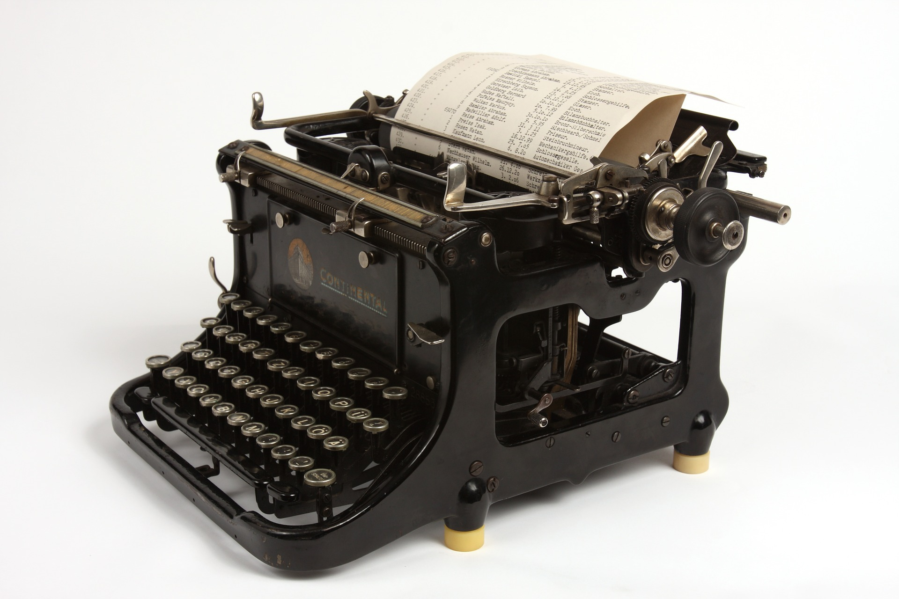
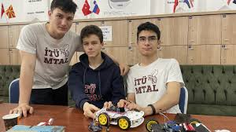
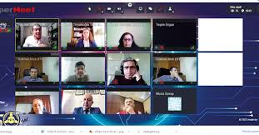
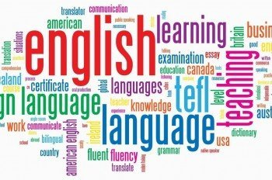
Prep Classes
English (main course& skills)/ 24 hours
Turkish Language and Literature / 4 hours
Math / 3 hours
Computer Science/Mobile app development / 4 hours
Physical Education and Sports / 2 hours
Visual Arts / 2 hours

Slide 7
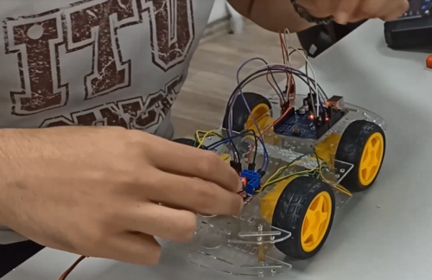
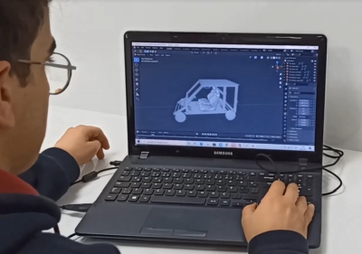
Electrical & Electronics Field
Industrial Maintenance and
Repair Branch
We have 9th (9 hours), 10th (14 hours), 11th (17 hours) grade
vocational students

Slide 8
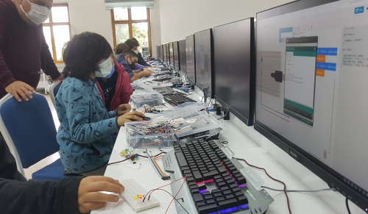
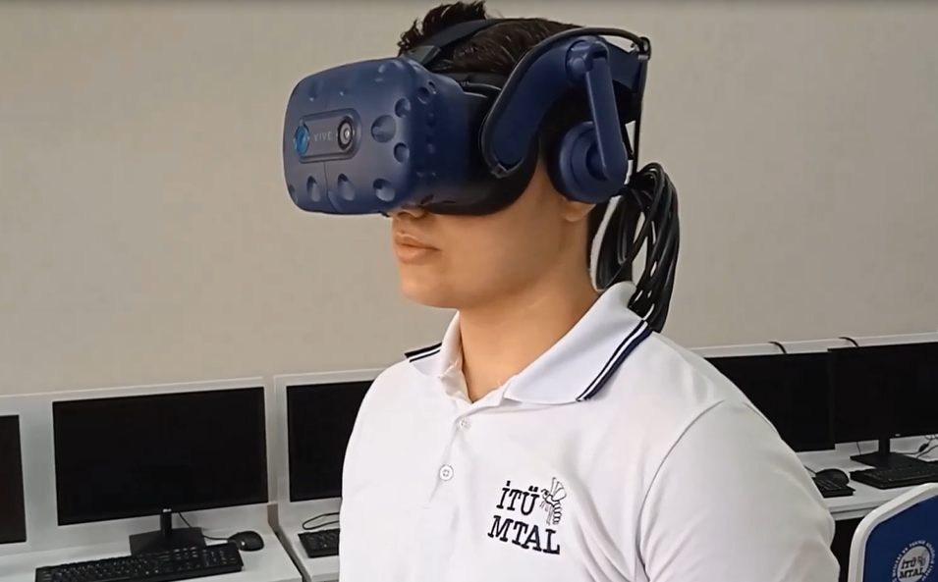
Information Technologies Field
Software Development Branch
We have 9th (9 hours), 10th (14 hours), 11th (17 hours) grade
vocational students

Slide 9
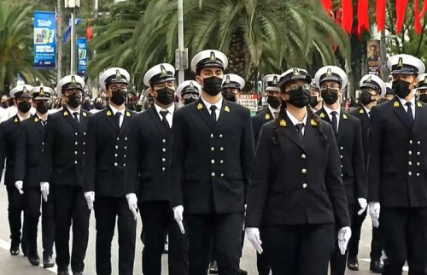
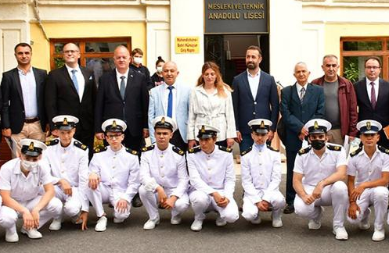
Maritime Field
Deck Business Branch
Ship Machinery Business
Branch
We have 9th (9 hours), 10th (14 hours), 11th (17 hours) grade vocational students
There is no 12th grade
vocational students

Slide 10

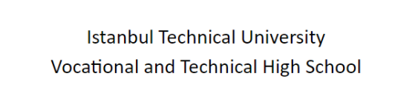
Our Projects and Activities
2023-2024

Slide 11
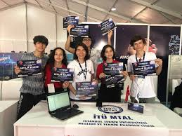
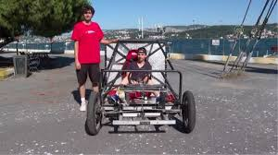
2023-2024 Academic Year Projects
Our Own Projects
1- Vocational Specialization Teamworks (Ahi-order)
2- Nasreddin Hodja Project
3- I Learn By Teaching Project
4- ARGEP360 - Augmented Reality Education Platform
Other Projects
1- Tübitak 4006
2- Teknofest
3- Erasmus Plus KA2
4- Harezmi
5- E-Twinning
6- …

Slide 12
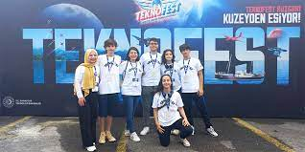
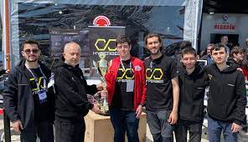
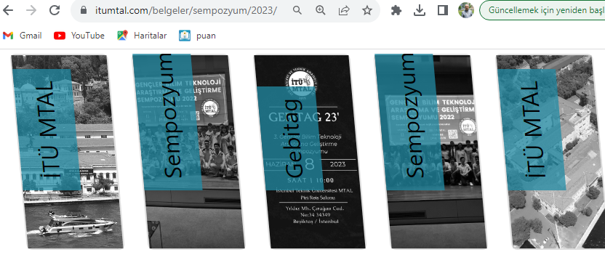
2023-2024 Academic Year Projects
Our Teams
Teknofest competition teams
MEB Robot competition teams
Ahi community teamworks
Nasreddin hodja project educator team
Autonomous ship team
Rocket team
E-car team
Tübitak projects team
National/international symposium organization team
…

Slide 13



2023-2024 Academic Year Projects
Erasmus Projects application team
E-Twinnig projects team
Harezmi project team

Slide 14

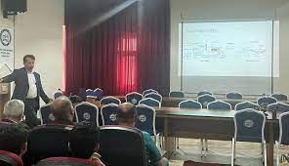
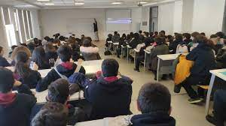
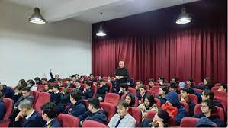
2023-2024 Academic Year Projects
Other Activities;
Scientists seminars
Academicians from ITU and their seminars
Online AR/VR and Robotics courses
Setting up new workshop - El Cezeri-1250
Istanbul Technical University workshop cooperate
Students’ domestic and foreign internship preparations
Sponsorship agreement with companies for setting up workshop
Prep classes’ attendance at the vocational lessons

Slide 15

2023-2024 Academic Year Projects
Social Activities;
Football
Basketball
Volleyball
Ping Pong
Second foreign language
English Speaking Activity
Manga
Painting
Music
Model plane
Short film
Photography
E-Twinning
Ottoman Turkish
Discussion
Theatre
Astronomy
Nasreddin Hodje
School’s social media
Chess
Intelligence games
…

Slide 16
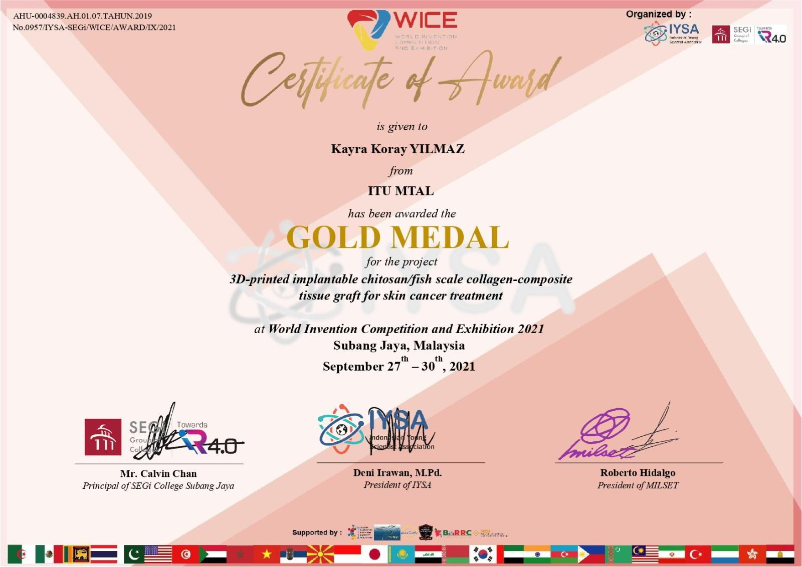
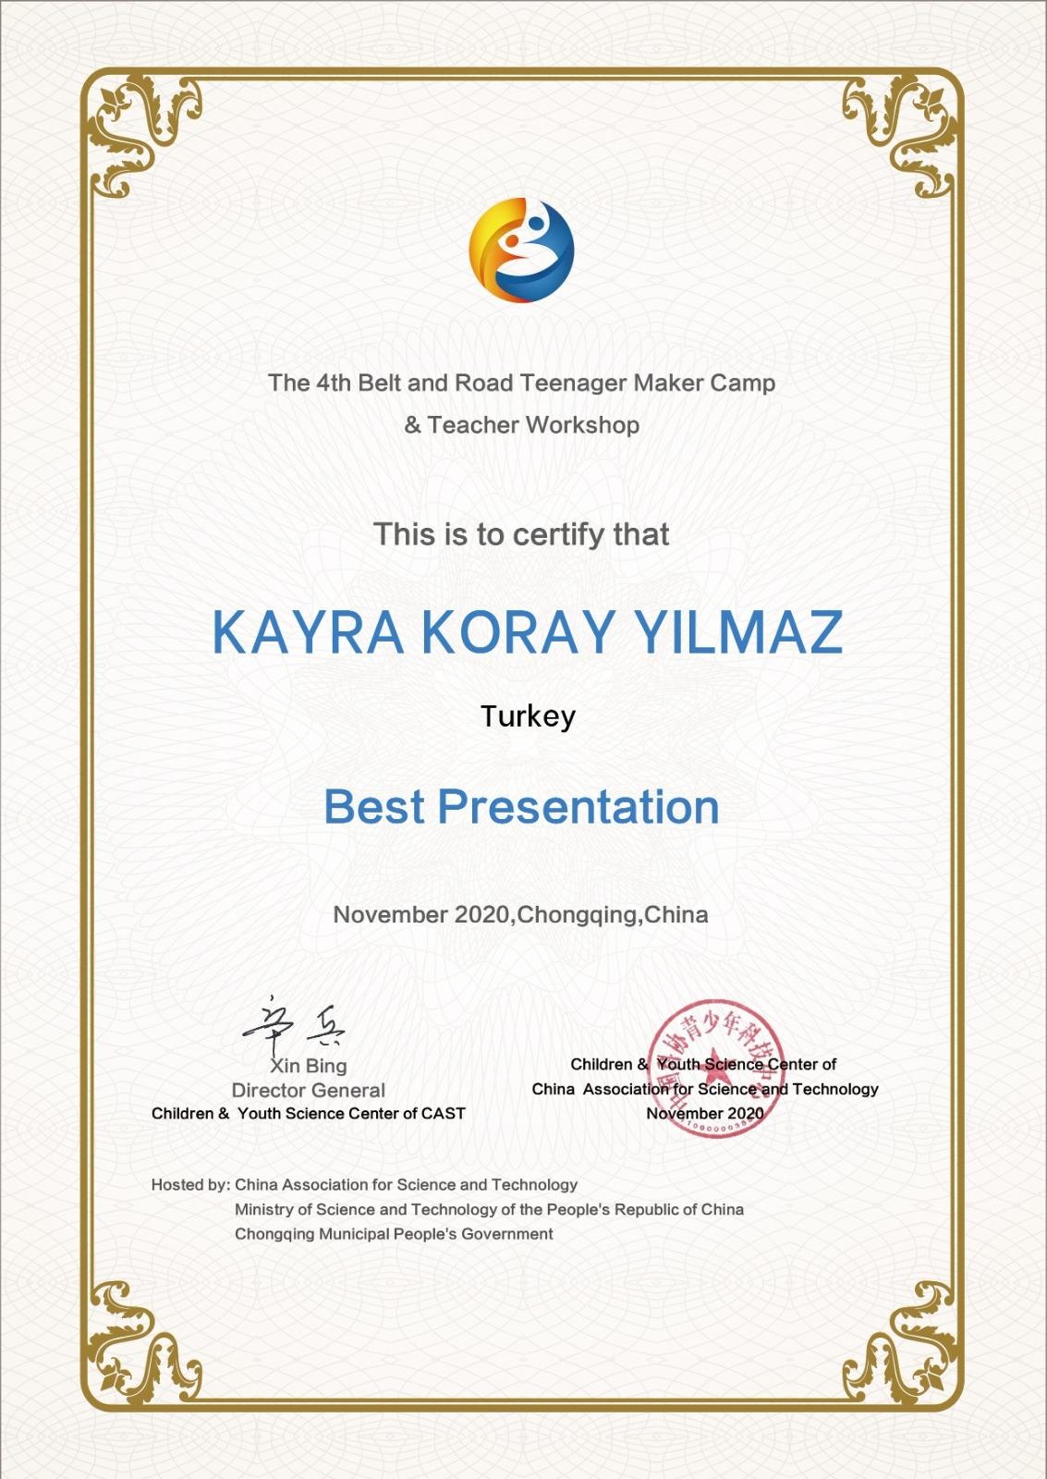
Achievements
We have many certificates in national and international competitions.

Slide 17
Teamworks
Vocational Specialization Platform
Ahi-order team work

Slide 18
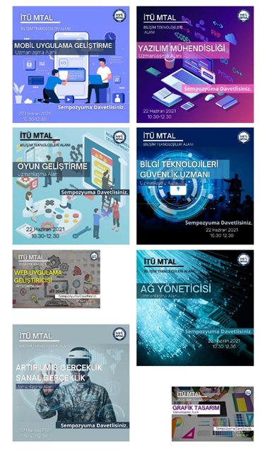
Department of Information Technologies
Ahi-order Teams
Mobile / Web Application Development
Game Development
Artificial intelligence / Machine Learning
Cyber Security
Blockchain
Network Management
Graphics and Design
Robotics and Coding
Cryptology
Augmented / Virtual Reality

Slide 19
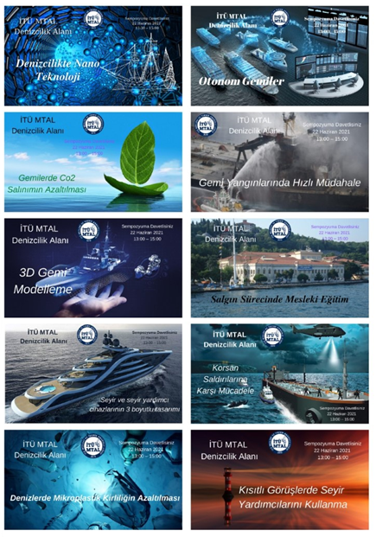
Department of Maritime
Ahi-order Teams
Augmented and Virtual Reality Applications in Maritime
Big Data Analytics in Maritime
Energy Management in Maritime
Human-Computer Interaction in Maritime
Blue Economy in Maritime
Automation in Maritime
Maritime Gamification
Cyber Security in Maritime
Digitization on Ships
Autonomous Ships

Slide 20
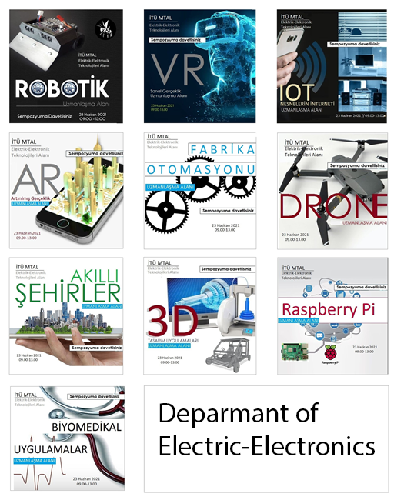
Electrical-Electronics Department
Ahi-order Teams
Smart Cities
Renewable Energy
Internet of Things
Virtual/Augmented Reality
Robotic Applications
Drone Applications
Rasperry Pi Applications
3D Desing
Biomedical Electronics
Factory automation

Slide 21
Nasreddin Hodja Academy
“Those who know, tell those who don't know.”

Slide 22
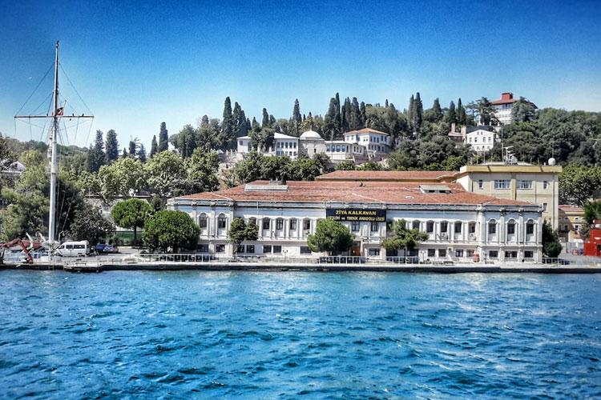
Current lessons within Nasreddin Hoca Academy
What trainings are currently being provided within the scope of this project?
Cyber Security
Augmented Reality
Phyton
Unreal Engine
Blender
Web page design
Arduino
3D design
Blender – Unreal engine
Entrepreneurship
How to play chess
Drone

Slide 23
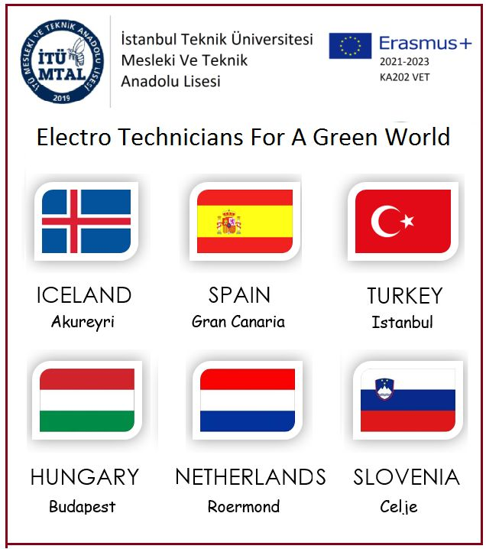
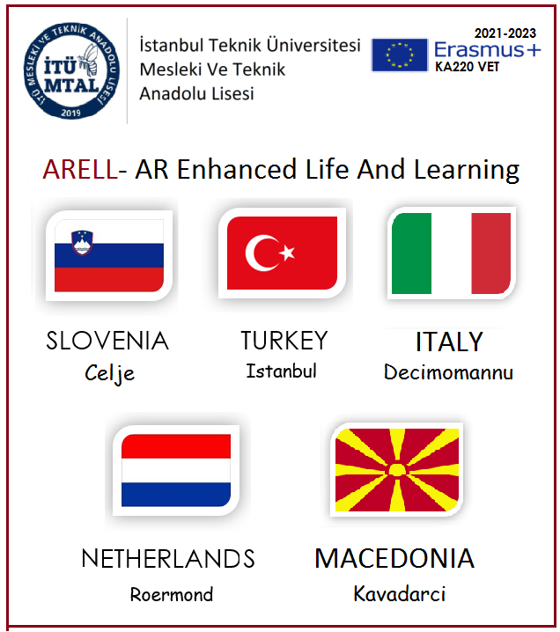
Who can attend the trainings?
For now, only on a school basis, but when our website www.itumtal.com is opened, other students who have applied to us through this website will be able to participate. We have Europen project so 9 countries are our project partners. They will also join our academy as well.
Why not with Malaysia

Slide 24
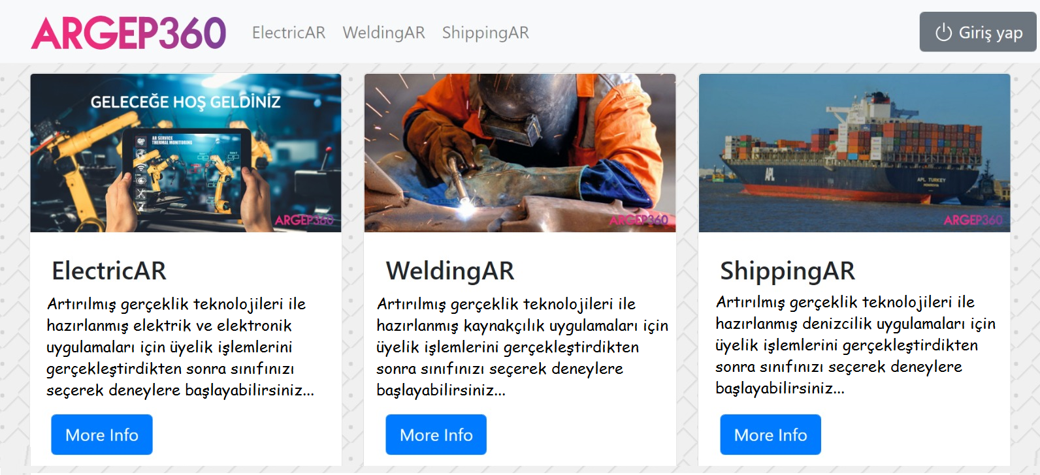
ARGEP-AR Training Platform

Slide 25

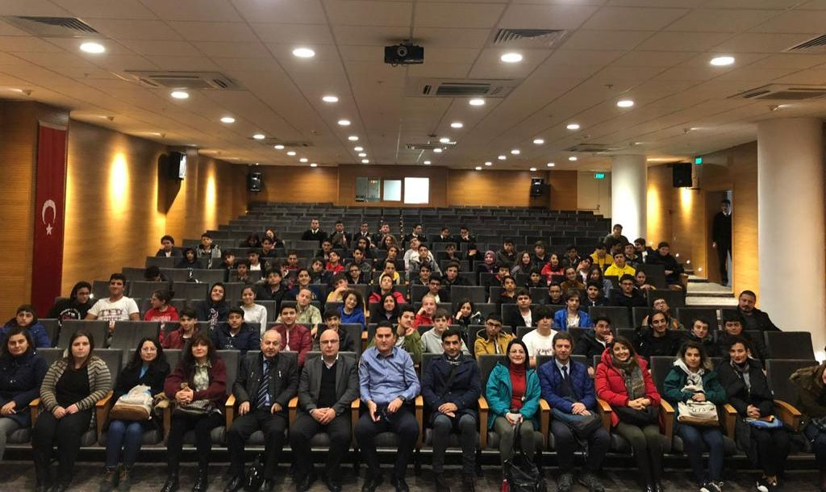
Hedef İTÜ
While project studies are at the forefront in the preparatory, 9th and 10th grades,
Hedef İTÜ (YKS, exam) based studies are at the forefront in the 11th and 12th grades.
HEDEF İTÜ
https://www.youtube.com/watch?v=uzf9f_VWQM4&feature=youtu.be
25

Slide 26




Contact
https://itumtal.meb.k12.tr https://itumtal.itu.edu.tr www.itumtal.com/belgeler itumtal@itu.edu.tr, 0212 261 24 20 https://www.youtube.com/itumtal
https://www.instagram.com/itumtal
https://twitter.com/itumtal
https://www.linkedin.com/company/itumtal
26

